Slide 1
Using Super-Resolution on Face Recognition
Presenter: Sheng-Hsing Hsiao
Advisor: Jyh-Shing Roger Jang
Dept. of CSIE, National Taiwan University, Taiwan

Slide 2
Outline
INTRODUCTION
RELATED WORKS
THE APPROACH
EXPERIMENTS
CONCLUSION
REFERENCES
Notes:
不要全部大寫

Slide 3
INTRODUCTION
Faces, a basic attribute that can distinguish one person to another. There are many well-known face recognition models have deployed on modern computer vision and multimedia applications.
In real world, the face recognition models need to meet the actual cases to identify the low-resolution human faces. It is essential to explore how to achieve an efficient method without losing too much on recognition accuracy.
To address this problem, we proposed a model reconstructing the high-resolution faces before recognition. In addition, we used FaceBoxes to detection faces and VGGFace with Resnet50 backbone as the face feature extractor can run 14 FPS on NVIDIA Quadro GV100 GPU.
Notes:
不要寫全部

Slide 4
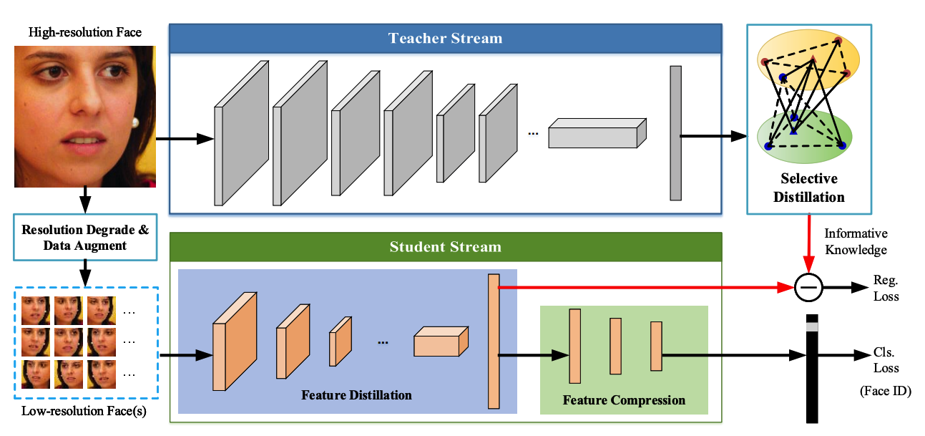
RELATED WORKS
Low-resolution Face Recognition in the Wild via Selective Knowledge Distillation
Two-stream convolutional neural network
https://arxiv.org/pdf/1811.09998.pdf
Notes:
老師stream是來分辨高解析度的圖
學生stream是分辨相對應低解析度的圖
老師stream會輸出最有用的face features 藉由解決sparse graph optimization
再用這些feature來fine tune學生stream 不佳s

Slide 5
THE APPROACH
Face Feature Extractor
Select the nearest distance of existing vectors
Face Detection
Super-Resolution
Notes:
the apose

Slide 6
EXPERIMENTS
Face Detection
Faceboxes: A CPU real-time face detector with high accuracy
https://arxiv.org/pdf/1708.05234
Notes:
Rapidly Digested Convolutional Layers 主要是解決速度問題
快速的縮小feature map的大小
採用C.ReLU activation function
使用CRelU來保證輸出維度不變的情況下，減少卷積核數量
Multiple Scale Convolutional Layers(MSCL)
類似於SSD，在網絡的不同層進行檢測
作者提出來的點就在於增加小的anchor的訓練
定義了anchor 密度 來平衡對密度不足的anchor來增加偏移訓練

Slide 7
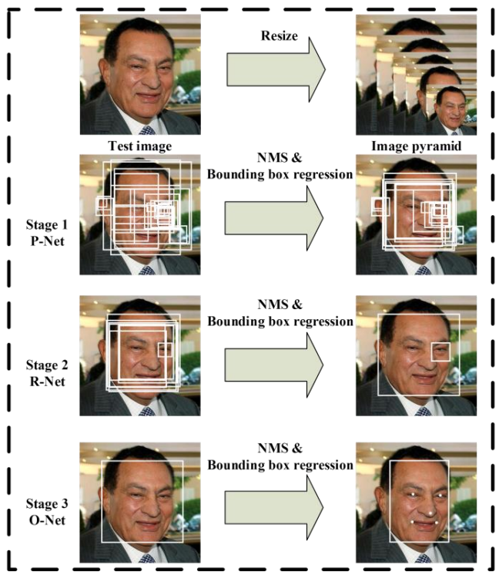
EXPERIMENTS
MTCNN: Joint Face Detection and Alignment using Multi-task Cascaded Convolutional Networks
https://arxiv.org/abs/1604.02878
Notes:
在2016年提出的一個multi-task 論文的人臉偵測還有人臉特徵同時進行
給定一張照片的時候，將其縮放到不同尺度形成圖像金字塔，以達到尺度不變
總共有三個CNN cascade
3個stage對人臉的處理是按照一種由粗到細的方式
pnet是一個全卷積網絡(FCN)，全卷積網絡的優點在於可以輸入任意尺寸的圖像，生成人臉分類、一些bounding box、還有人臉上的landmark
使用Bounding box regression的方法來校正這些候選窗
使用非極大值抑制（NMS）合併重疊的候選框

Slide 8
EXPERIMENTS
NMS (Non-maximum suppression)
Notes:
幾個框都檢測到了人臉，但是我不需要這麼多的框，我需要找到一個最能表達人臉的框
我們的目標是一個人只保留一個最優的框
將所有框的得分排序，選中最高分及其對應的框

Slide 9
EXPERIMENTS
NMS (Non-maximum suppression)
Notes:
遍歷其餘的框，如果和當前最高分框的重疊面積(IOU)大於一定閾值，我們就將框刪除。

Slide 10
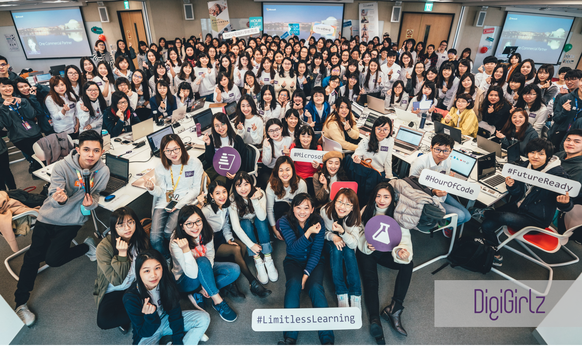
EXPERIMENTS
Compare MTCNN with FaceBoxes
Original Image (2000x1210)

Slide 11
EXPERIMENTS
Compare MTCNN with FaceBoxes
Original Image (2000x1210)

Slide 12
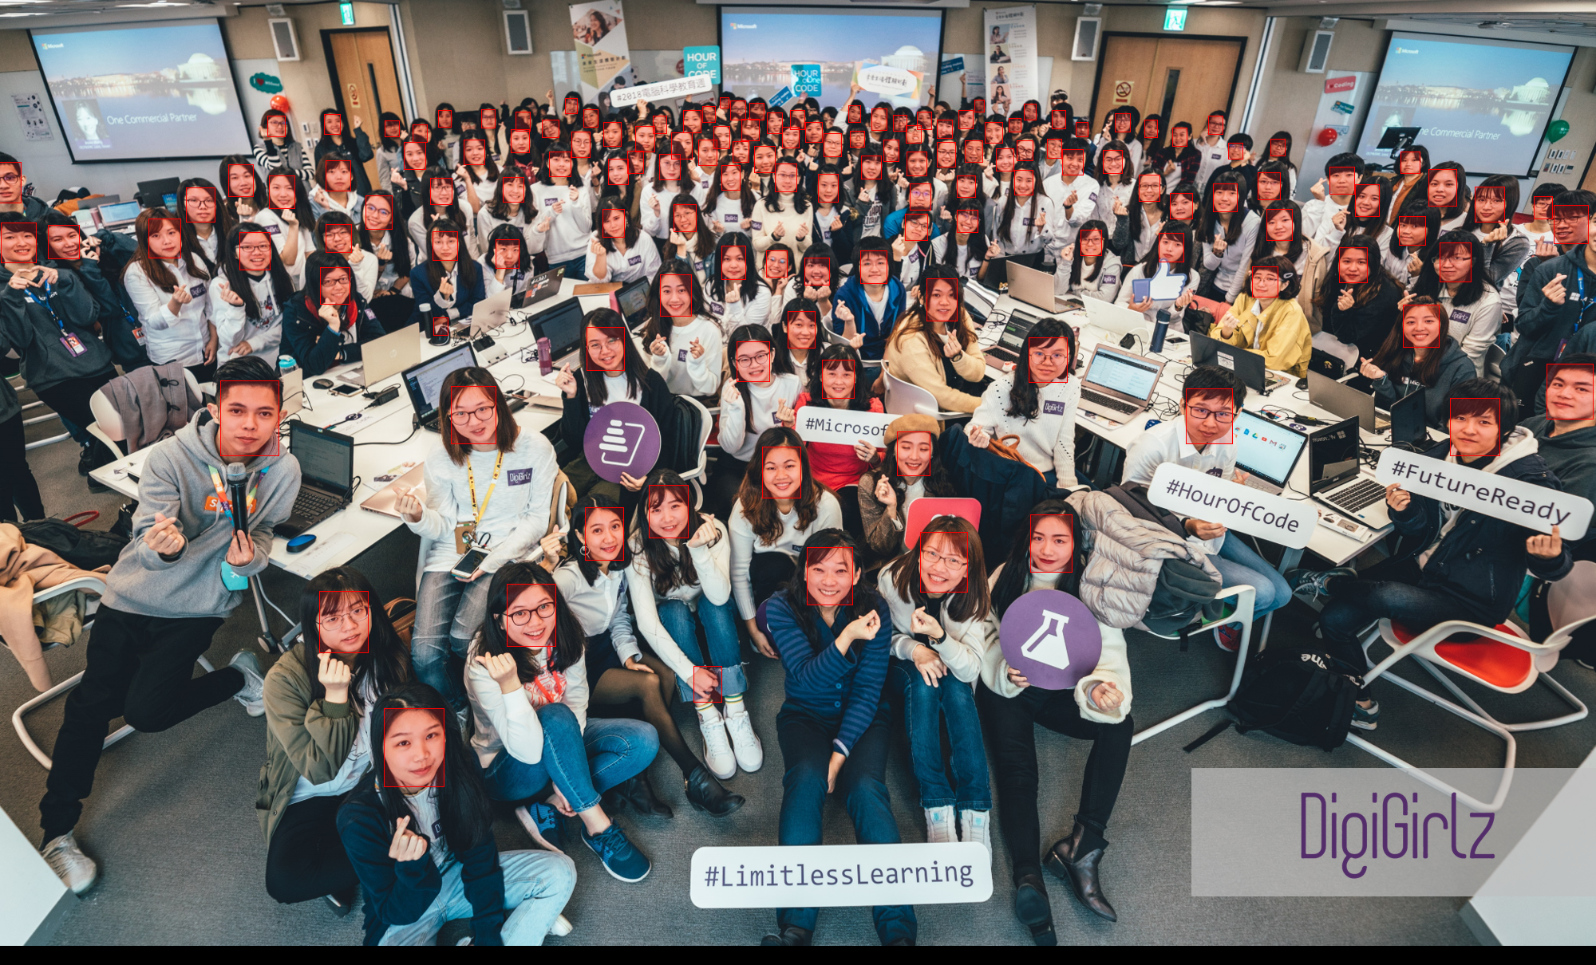
EXPERIMENTS
Compare MTCNN with FaceBoxes
MTCNN (1.38s, 140 faces)

Slide 13

EXPERIMENTS
Compare MTCNN with FaceBoxes
FaceBoxes (0.019s, 93 faces)
)

Slide 14
EXPERIMENTS
Super-Resolution
WDSR (Wide Activation for Efficient and Accurate Image Super-Resolution, CVPR Workshop 2018)

Slide 15
EXPERIMENTS
Super-Resolution Dataset: VGGFace2 (A large scale image dataset for face recognition)
9,000 + identities
3.3 million + faces
362 ~ per-subject samples
My method
Select images whose shape above 1k as our training data.
Face alignment according bounding boxes provided by the dataset.
Downscale these images x1/2, x1/3, x1/4.

Slide 16
EXPERIMENTS
Downscale the high-resolution images

Slide 17
EXPERIMENTS
Result of the WDSR on VGGFace2
HR
Bicubic X4
WDSR X4
HR

Slide 18
EXPERIMENTS
Face Recognition Dataset: LFW Face Dataset
5749 celebrities, each contains 1~10 images, 13233 images in total
My method:
For each celebrity, downloaded 10 images from google.
Applied Vgg16/Resnet50/Facenet face feature extractor to encode these images and merged to a NumPy array.
Encoded every image in LFW dataset and calculated the distance with each person’s feature.

Slide 19
EXPERIMENTS
Evaluate Face Recognition on LFW (1x)
Notes:
抽feature講清楚for face

Slide 20
EXPERIMENTS
Results of Bicubic and Super-Resolution on LFW

Slide 21
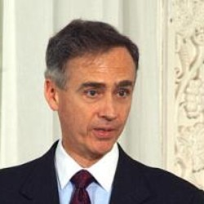

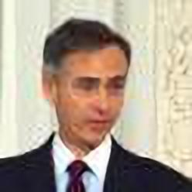
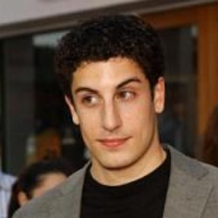

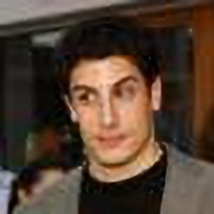
EXPERIMENTS
Results of Bicubic and Super-resolution
HR
Bicubic4x
SR4x
HR
Bicubic4x
SR4x

Slide 22
CONCLUSION

Slide 23
Thank you for your attention

